Slide 1

CSA03 Data Structures
CO1 Assessment Tool 2: Technical Presentation
Presented by
P.Nandhini
192313041

Slide 2


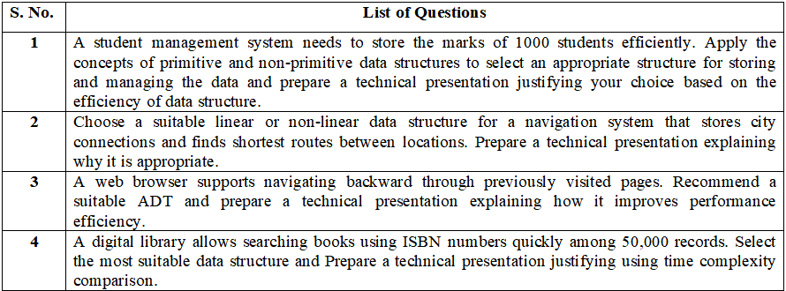

Slide 3


Slide 4
1.Primitive vs non-primitive types
Primitive data types
1,000
Examples: int, float, char, boolean
Hold a single value of fixed size. Fast, but one variable per mark.
student marks to store
Declaring 1,000 separate primitive variables is impractical. We need one structure that groups them.
Non-primitive data structures
Examples: array, linked list, stack, queue, tree, graph
Hold collections of values and define how they are organised and accessed.
Notes:
A student management system must store 1,000 marks. Primitive types hold a single value, so 1,000 separate variables would be unmanageable. Non-primitive structures group many values and define how they are accessed.

Slide 5
Choice: a one-dimensional array
78
92
65
88
. . .
71
marks[0]
marks[1]
marks[2]
marks[3]
marks[999]
Contiguous memory: address of marks[i] = base address + i x element size
Direct access
Fixed, known size
marks[i] is reached in O(1) using the index.
Exactly 1,000 records, so no resizing is needed.
Minimal memory
Easy to process
No pointers: 1,000 ints take about 4 KB, O(n).
Simple loops give total, average, rank and sort.
Notes:
A 1-D array stores all 1,000 marks in consecutive memory locations. The address of marks[i] is base + i times element size, so any mark is reached in constant time. For several subjects, extend to a 2-D array marks[1000][subjects].

Slide 6
Efficiency of the array
Operation | Time
Access or update marks[i] | O(1)
Total or average of all marks | O(n)
Linear search for a mark | O(n)
Binary search (sorted marks) | O(log n)
Insert or delete in the middle | O(n)
about 4 KB
1,000 ints x 4 bytes, space O(n)
O(1)
access to any student's mark
Verdict: a 1-D array gives the fastest access with the least memory for fixed-size marks data.
Notes:
Access and update are O(1) because of index arithmetic. Totals, averages and linear search touch every element, so O(n). If the marks are sorted, binary search gives O(log n). Insertion or deletion in the middle shifts elements, O(n), but this is rare for a fixed class list.

Slide 7
2.Why a graph fits navigation
Hyderabad
Cities
Each city is a vertex (node).
560
630
Pune
Roads
Chennai
570
Each road is an edge with a weight: distance or time.
850
150
350
Why not linear?
Bengaluru
Mumbai
Lists and stacks cannot show many-to-many connections.
Illustrative road distances in km
Notes:
A road map is a many-to-many network. Cities are vertices and roads are weighted edges. Linear structures such as arrays, lists, stacks and queues cannot express branching connections. Distances shown are illustrative.

Slide 8
Representing the road network
Adjacency matrix
Adjacency list (chosen)
V x V table of distances
Space: O(V^2)
Is there a road? O(1)
List a city's roads: O(V)
Wastes memory: road maps are sparse
Each city stores its neighbouring roads
Space: O(V + E)
List a city's roads: O(degree)
Fits sparse road networks
Chennai : Bengaluru, Hyderabad
Hyderabad : Chennai, Bengaluru, Pune
Pune : Bengaluru, Hyderabad, Mumbai
Notes:
An adjacency matrix needs V squared cells, which is wasteful because road networks are sparse. An adjacency list stores only the actual roads, using O(V + E) space, and lists a city's neighbours in time proportional to its degree.

Slide 9
Shortest route: Dijkstra's algorithm
From Chennai to | km | Route
Bengaluru | 350 | direct
Hyderabad | 630 | direct
Pune | 1,190 | via Hyderabad
Mumbai | 1,340 | via Hyderabad, Pune
O((V + E) log V)
with a min-heap priority queue
O(V^2)
with a plain array (slower)
Shortest Chennai to Mumbai route: 1,340 km
Chennai
630
Hyderabad
560
Pune
150
Mumbai
Notes:
Dijkstra repeatedly picks the unvisited city with the smallest known distance and relaxes its outgoing roads. With a min-heap priority queue the cost is O((V + E) log V). It requires non-negative weights, which holds for distances and travel times. Result from Chennai: Bengaluru 350, Hyderabad 630, Pune 1190 via Hyderabad, Mumbai 1340 via Hyderabad and Pune.

Slide 10
3.Back navigation needs LIFO order
Home
Search results
Article
Video (current)
Remember order
Latest first
One-end access
History must keep pages in the sequence they were visited.
Back needs the most recently visited page, not the oldest.
Add and remove only at the top: ideal for a Stack ADT.
Notes:
Pressing Back must return to the most recently visited page, so the last page in is the first page out. That is exactly the Last-In-First-Out rule of a stack. An ADT defines behaviour (push, pop, peek, isEmpty) without fixing the implementation.

Slide 11
How the Stack ADT works
Video (top)
push(page)
Visit a page: place it on top. O(1)
Article
pop()
Back button: remove the top, show the next. O(1)
Search results
peek()
Read the current page without removing it. O(1)
Home (bottom)
isEmpty()
Disable Back when no history is left. O(1)
LIFO: last in, first out
Notes:
Visiting a page pushes it on top. Pressing Back pops the top and shows the new top. Peek reads the current page, and isEmpty disables the Back button. Every operation touches only the top, so each is O(1). A second stack can hold pages for the Forward button.

Slide 12
Why it boosts performance
Approach | Back | Visit
Stack (top pointer) | O(1) | O(1)
Array, shift items | O(n) | O(n)
Scan list for last page | O(n) | O(1)
Queue (FIFO) | Wrong page | O(1)
O(1)
per Back or Visit, however long the history
1,000 pages of history
Stack: 1 step. Shifting an array: up to 1,000.
Memory: O(n)
One entry per page. A second stack powers Forward.
Notes:
A stack gives O(1) visit and O(1) back, regardless of history length. Shifting an array or scanning a list costs O(n) per action. A queue is FIFO so it would return the oldest page, which is the wrong behaviour. Memory is O(n), one entry per page.

Slide 13
4.The problem: 50,000 ISBN records
50,000
Linear search
Scan every record: up to 50,000 checks.
book records
Binary search
Needs sorted data: about 16 checks.
Key: unique 13-digit ISBN
Need: instant search and quick insert
BST
Sorted tree: about 16 average, can skew.
Hash table
Jump by key: about 1 check on average.
Notes:
The library needs very fast lookup by ISBN among 50,000 records. ISBN-13 is a unique key, which suits key-based structures. We compare linear search, binary search on a sorted array, a binary search tree and a hash table.

Slide 14
Hash table: jump straight to the record
1 KEY
2 HASH
3 INDEX
4 BUCKET
ISBN-13 number
h(k) = k mod m
Array slot 0 to m-1
Compare ISBN, return book
Sizing the table
Handling collisions
m is about 66,000 buckets (1.3 x n)
Load factor = n / m is about 0.75
Average chain stays below 1 record
Different ISBNs can share an index
Chaining: bucket holds a short list
Search cost: O(1 + load) = O(1)
Notes:
The ISBN is passed through a hash function h(k) = k mod m to get an array index. Collisions are handled by chaining: each bucket holds a short linked list. With m about 66,000 and n = 50,000, the load factor is about 0.75, so the average chain is shorter than one record and search is O(1 + alpha), effectively O(1).

Slide 15
Time complexity comparison
Method | Average | Worst | Avg steps
Linear search | O(n) | O(n) | 25,000
Binary search | O(log n) | O(log n) | 16
BST | O(log n) | O(n) | 16
Hash table | O(1) | O(n) | 1 to 2
Verdict: a hash table gives average O(1) lookup, thousands of times fewer checks than linear search on 50,000 ISBNs.
Notes:
For n = 50,000: linear search averages 25,000 comparisons; binary search and a balanced BST need about 16 (log2 50,000 is about 15.6); a hash table needs about one or two. Hashing has O(n) worst case only if everything collides, which a good hash function and load factor avoid. If range queries or sorted order were needed, a balanced tree such as a B-tree would be preferred.

